Slide 1
More on Perceptron Learning
CSE301 Bio-computation
Week 4, 2016
Bailing Zhang

Slide 2
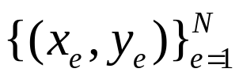
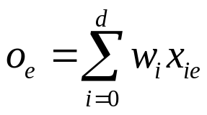

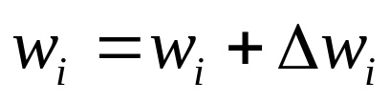
Review: Gradient Descent Learning Algorithm
Initialization: Examples , initial weights w_{i} set to small random values, learning rate parameter η = 0.1
Repeat
for each training example ( x_{e}, y_{e} )
  - calculate the output:
  - if the Perceptron does not respond correctly compute weight corrections:
  update the weights with the accumulated error from all examples
  until termination condition is satisfied.
until termination condition is satisfied.
Gradient Descent Rule

Slide 3
On-line vs. Batch Learning Algorithms
The Delta Rule
The gradient descent rule faces two difficulties in practice:
- it converges very slowly
- if there are multiple local minima in the error surface, then
there is no guarantee that it will find the global minimum
That is why, a stochastic version called incremental gradient descent rule is developed to overcome these difficulties.
Whereas the gradient descent rule updates the weights after calculating the whole error accumulated from all examples, the incremental version approximates the gradient descent error decrease by updating the weights after each training example.

Slide 4
The Delta Rule
Incremental gradient descent is implemented according to the Delta rule:
The Delta rule is also called LMS (least-mean-square) rule or Widrow-Hoff rule.
Incremental Gradient Descent Learning
Algorithm
Initialization: Examples {( x_{e}, y_{e} )}_{e=1}^{N}, initial weights wi set to small random values, learning rate parameter η= 0.1

Slide 5

Repeat
for each training example ( x_{e}, y_{e} )
calculate the output:
if the Perceptron does not respond correctly update
the weights:
w_{i} = w_{i} + η ( y_{e} - o_{e} ) x_{ie} // this is the Delta Rule
until termination condition is satisfied.

Slide 6
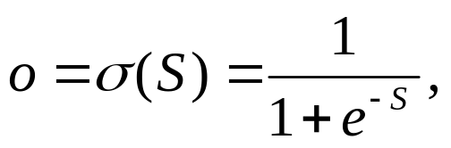
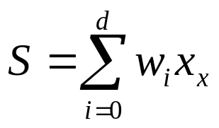
Sigmoidal Perceptrons
The simple single-layer Perceptrons with threshold or linear activation functions are not generalizable to more powerful learning mechanisms like multilayer neural networks.
  That is why, single-layer Perceptrons with sigmoidal activation functions are developed.
The sigmoidal Perceptron produces output:
where:

Slide 7
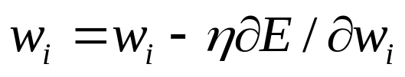

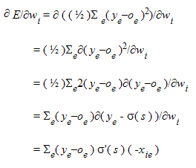
Training Sigmoidal Perceptrons
The Gradient descent rule for training sigmoidal Perceptrons is again:
The difference is in the error derivative which due to the use of the sigmoidal function σ( s ) becomes:
where x_{ie} denotes the i-th component of the example

Slide 8
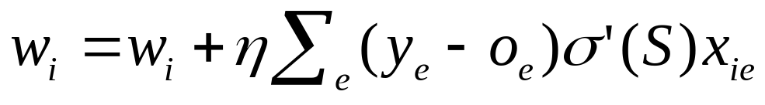
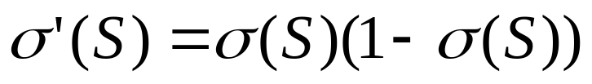
The Gradient descent training rule for training sigmoidal Perceptrons is:
where:

Slide 9
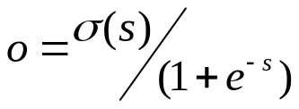
Gradient Descent Learning Algorithm for Sigmoidal Perceptrons
Initialization: Examples {( x_{e}, y_{e})}_{e=1}^{N}, initial weights w_{i} set to small random values, learning rate parameter η = 0.1
Repeat
for each training example ( x_{e}, y_{e} )
- calculate the output: where s=∑_{i=0}^{d} w_{i} x_{ie}
- if the Perceptron does not respond correctly compute weight corrections:
update the weights with the accumulated error from all examples
until termination condition is satisfied.
_{Gradient Descent Rule}

Slide 10
Example
Suppose an example of Perceptron which accepts two inputs x₁ and x₂, with weights w₁ = 0.5 and w₂ = 0.3 and w₀ = -1.
Let the following example is given: x₁ = 2, x₂ = 1, y = 0
The output of the Perceptron is :
O = σ(-1+2 * 0.5 + 1 * 0.3 ) = σ (0.3)=0.5744
The weight updates according to the gradient descent algorithm will be:
Δ w₀ = ( 0 - 0.5744 ) * 0.5744 * ( 1 -0.5744 ) * 1 = - 0.1404
Δw₁ = ( 0 - 0.5744 ) * 0.5744 * ( 1 -0.5744 ) * 2 = - 0.2808
Δ w₂ = ( 0 - 0.5744 ) * 0.5744 * ( 1 -0.5744 ) * 1 = - 0.1404

Slide 11
Example
Let another example is given: x₁ = 1, x₂ = 2, y = 1
The output of the Perceptron is :
O = σ(-1+1 * 0.5 + 2 * 0.3 ) = σ (0.1)=0.525
The weight updates according to the gradient descent algorithm
will be:
Δw₀ = - 0.1404 + ( 1 - 0.525 ) * 0.525 * ( 1 - 0.525 ) * 1 = -0.0219
Δw₁ = - 0.2808 + ( 1 - 0.525 ) * 0.525 * ( 1 - 0.525 ) * 1 = -0.1623
Δw₂ = - 0.1404 + ( 1 - 0.525 ) * 0.525 * ( 1 - 0.525 ) * 2 = 0.0966
If there are no more examples in the batch, the weights will be
modified as follows:
    w₀ = - 1 + ( -0.0219 ) = -1.0219
    w₁ = 0.5 + ( -0.1623 ) = 0.3966
    w₂ = 0.3 + 0.0966 = 0.3966

Slide 12


Incremental Gradient Descent Learning Algorithm for Sigmoidal Perceptrons
Initialization: Examples {( xe, ye )}e=1N, initial weights w_{i} set
to small random values, learning rate parameter η= 0.1
Repeat
for each training example ( x_{e}, y_{e} )
  calculate the output:
  where s=∑ _{i=0}^{d} w_{i} x_{ie}
  If the Perceptron does not respond correctly update the weights:
  // Incremental Gradient Descent Rule
  until termination condition is satisfied.

Slide 13
Perceptron vs. Delta Rule
Delta rule finds the decision boundary which minimizes the sum squared error of the (target - net) value rather than the (target - output) value
  Perceptron rule will find the decision boundary which minimizes the classification error – if the problem is linearly separable
  The delta rule decision boundary may leave more instances misclassified as compared to the perceptron rule
Perceptron rule (target - thresholded output) guaranteed to converge to a separating hyperplane if the problem is linearly separable. Otherwise may not converge - get in cycle
Notes:
Assume they red and blue are 4 units apart. Show SSE and why it will go to the middle. Note that Delta rule will often not put the line in the intuitive place (not like for regression), because of the output targets

Slide 14
Perceptron rule vs Delta rule
(Singe layer) Delta rule guaranteed to have only one global minimum. Thus it will converge to the best SSE solution whether the problem is linearly separable or not.
  Could have a higher misclassification rate than with the perceptron rule
Stopping Criteria – For these models stop when no longer making progress
  When you have gone a few epochs with no significant improvement

Slide 15
The error surface
The error surface lies in a space with a horizontal axis for each weight and one vertical axis for the error.
  For a linear neuron, it is a quadratic bowl.
  Vertical cross-sections are parabolas.
  Horizontal cross-sections are ellipses.
E
w1
Vertical cross-section
w2

Slide 16
Online versus batch learning
Batch learning does steepest descent on the error surface
Online learning zig-zags around the direction of steepest descent
constraint from
training case 1
w1
w1
constraint from
training case 2
w2
w2

Slide 17
Summary
perceptron training rule:
  uses thresholded unit
  converges after a finite number of iterations
  output hypothesis classifies training data perfectly
  linearly separability neccessary
delta rule:
  uses unthresholded linear unit
  converges asymptotically toward a minimum error hypothesis
  termination is not guaranteed
  linear separability not neccessary

Slide 18
The Fall of the Perceptron
Marvin Minsky & Seymour Papert (1969). Perceptrons, MIT
Press, Cambridge, MA.
Before long researchers had begun to discover the Perceptron’s limitations.
Unless input categories were “linearly separable”, a perceptron could not learn to discriminate between them.
Unfortunately, it appeared that many important categories were not linearly separable.
E.g., those inputs to an XOR gate that give an output of 1 (namely 10 & 01) are not linearly separable from those that do not (00 & 11).

Slide 19
Suggested Readings
Bishop,C. (1995) "Neural Networks for Pattern Recognition", Oxford University Press, Oxford, UK, pp.98-105.
Haykin, Simon. (1999). "Neural Networks. A Comprehensive Foundation", Second Edition, Prentice-Hall, Inc., New Jersey, 1999.

